Slide 1
Building Web Applications Using the Spring Framework

Slide 2
Objectives
In this session, you will learn to:
Inject application objects
Explore Spring MVC
Handle Web requests

Slide 3
Injecting Application Objects
The process of creating and managing association among application objects forms the core of DI and is commonly referred to as wiring.
To inject dependencies into the application objects, you need to configure them in an XML-based configuration file.
In this file, you should first give a definition for the bean for which the dependency is to be created.
Injected into
Customer
Order
Injected into
Product
Bean wiring
Explicit wiring
Autowiring

Slide 4

Applying Explicit Wiring
You can explicitly wire the beans by declaring their dependencies in the configuration file.
While declaring the beans in the configuration file, you can also wire its properties.
You can explicitly wire the bean properties in the configuration file by:
Using setter injection
Using constructor injection

Slide 5
Applying Explicit Wiring (Contd.)
Setter injection is a bean wiring technique in which the JavaBean setter methods are used for supplying the bean properties to the objects that need them.
You can wire the bean properties in a Spring-enabled application by declaring a <property> element for the bean in the configuration file within the <bean> tag.
Using setter injection
The <property> element can inject dependencies using the setter methods of the property in the following ways:
Injecting simple values
Referencing other beans

Slide 6
Applying Explicit Wiring (Contd.)
You can use the value attribute of the <property> element to inject a string value into a bean property.
The value attribute can also take on values of the other types, such as integer, floating point, and boolean.
Injecting simple values
Example: Player interface
package com.techtails;
public interface Player
{
void play();
}

Slide 7
Applying Explicit Wiring (Contd.)
Example: FootballPlayer class that implements the Player interface
package SetterInject;
public class FootballPlayer implements Player{
public FootballPlayer() {}
@Override
public void play() {
System.out.println("I am playing with " + football + " football.");
}
private String football;
public void setFootball(String football){
this.football = football;
}
private FootballBoots boots;
public void setBoots(FootballBoots boots){
this.boots = boots;
}
}

Slide 8
Applying Explicit Wiring (Contd.)
Example: The FootballBoots interface
package SetterInject;
public interface FootballBoots
{
void wearBoots();
}
Example: Bean wiring
<bean id="Kaka"
class="SetterInject.FootballPlayer">
<property name="football" value="Adidas"/>
</bean>
<bean id="Forlan"
class="SetterInject.FootballPlayer">
<property name="football" value="Nike"/>
</bean>

Slide 9
Applying Explicit Wiring (Contd.)
To wire beans with each other, you have to specify bean references in the bean configuration file.
You can specify a bean reference for a bean property by using the ref attribute of the <property> element.
The ref attribute sets the value of the specified property of the bean by passing to it a reference of another bean.
Referencing other beans
Example: FootballBoots class
package SetterInject;
public class Predator implements FootballBoots {
public Predator () {}
public void wearBoots () {
System.out.println("I am wearing Adidas predator boots.");
}
}

Slide 10
Applying Explicit Wiring (Contd.)
Example: Bean configuration
<bean id="predator"
class="SetterInject.Predator"/>
Example: Bean wiring
<bean id="Kaka"
class="SetterInject.FootballPlayer">
<property name="football" value="Adidas" />
<property name="boots" ref="predator" />
</bean>
<bean id="Forlan"
class="SetterInject.FootballPlayer">
<property name="football" value="Nike" />
<property name="boots" ref="predator" />
</bean>

Slide 11
Applying Explicit Wiring (Contd.)
It is a bean wiring technique, where an object is provided its dependencies via its own constructors.
The dependencies are passed as arguments of the constructors with each representing a property or a collaborator object.
In this method, each object declares a constructor or a set of constructors that take object dependencies as arguments.
Using constructor injection

Slide 12
Applying Explicit Wiring (Contd.)
Example: Updated FootballPlayer class
package SetterInject;
public class FootballPlayer implements Player{
private int shirtNumber;
public FootballPlayer() {}
public FootballPlayer(int shirtNumber){
this.shirtNumber= shirtNumber;
}
@Override
public void play() {
System.out.println("I am playing with shirt number " + shirtNumber +".");
}
}

Slide 13
Applying Explicit Wiring (Contd.)
Example: Bean wiring
<bean id="Kaka"
class="SetterInject.FootballPlayer">
<constructor-arg value="7"/>
</bean>
<bean id="Forlan"
class="SetterInject.FootballPlayer">
<constructor-arg value="21"/>
</bean>

Slide 14
Applying Autowiring
The property name or the constructor argument is not declared within the configuration file.
The Spring container itself finds the type and name of the property and matches the property type and name with other beans in the container based on their specified type or name.
In this method, each object declares a constructor or a set of constructors that take object dependencies as arguments.
Wiring is achieved by setting the autowire property of the beans.
In autowiring

Slide 15
Applying Autowiring (Contd.)
Values of the autowire property
byName
byType
Bean is matched whose name matches the name of the property being wired.
Bean is matched whose type matches the type of the property being wired.
constructor
no
Bean is matched based on the parameters of the constructors of the bean that is being wired.
No autowiring at all. Bean references must be defined via a ref element

Slide 16
Applying Autowiring (Contd.)
If the name of a property matches the name of the bean that has to be wired into that property, the Spring framework can automatically wire that bean into the property.
Autowiring by name
Example: Bean wiring
Example: Bean configuration
<bean id="Kaka"
class="SetterInject.FootballPlayer">
<property name="football" value="Adidas"/>
<property name="boots" ref="predator"/>
</bean>
<bean id="boots"
class="SetterInject.Predator"/>
Example: Bean autowiring
<bean id="Kaka"
class="SetterInject.FootballPlayer"
autowire="byName">
<property name="football" value="Adidas" />
</bean>

Slide 17
Applying Autowiring (Contd.)
Spring attempts to find a bean whose type is compatible with the property type.
Autowiring by type
Example:
<bean id="boots"
class="SetterInject.Predator"/>
<bean id="Kaka"
class="SetterInject.FootballPlayer"
autowire="byType">
<property name="football" value="Adidas" />
</bean>

Slide 18
Applying Autowiring (Contd.)
Is achieved by setting the autowire property to constructor.
Spring automatically selects constructor arguments from the beans, defined in the configuration file.
Autowiring by constructor
Example:

Slide 19
Applying Autowiring (Contd.)
Autowiring by constructor
Example: Bean wiring
<bean id="Wilkinson"
class="AutowireInject.RugbyPlayer" autowire="constructor">
<property name="shirtNumber" value="7"/>
</bean>
<bean id="NikeBoots"
class="AutowireInject.RugbyBoots">
<property name="boots" value="Nike"/>
</bean>

Slide 20


Activity: Wiring Application Objects
Let us see how to wire application objects.
Perform Activity 2.1: Wiring Application Objects

Slide 21
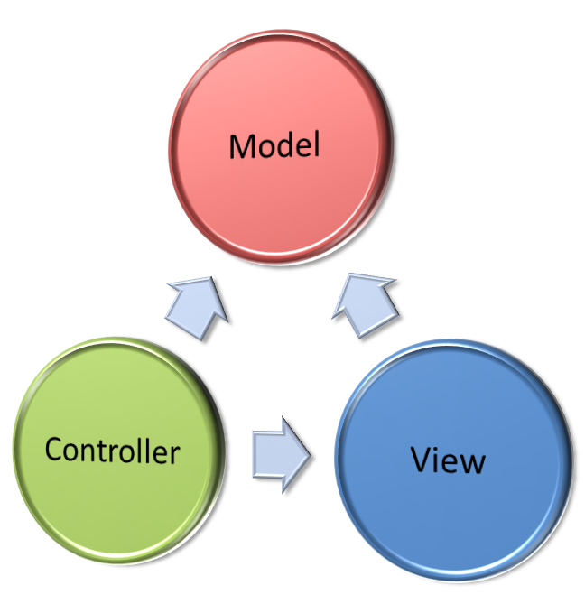

Exploring Spring MVC
Is an MVC design pattern extension that allows you to represent the UI flow of a Web application into individual controllers and views.
Features
Pluggable view technology
Injection of services into controllers
Integration support

Slide 22
Introducing Spring MVC Framework
Represents the data that an application persists.
Responsible for receiving the user request and passes it to the model.
Represents the UI of the application.
The core idea of the MVC pattern is to separate the business logic from UIs to allow them to change independently without affecting each other.
The Spring Web MVC framework advantage of the AOP and DI features of the Spring framework to help you create loosely coupled Web applications.

Slide 23
Introducing Spring MVC Framework (Contd.)
The Spring Web MVC framework is built around a front controller servlet called dispatcher servlet.
The dispatcher servlet is responsible for delegating the user request to various components of the application while executing a user request.
The Spring MVC framework makes use of the following components while processing a user request:
View resolvers
View
Handler mappings
Controllers

Slide 24
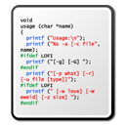




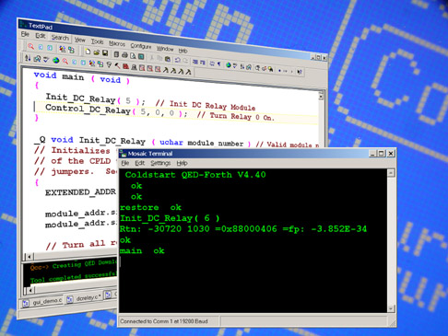
Benefits of the Spring MVC Framework
Reusable application code
Simple and powerful tag library
Ease of testing
Benefits of information analysis
Supports multiple view technologies and Web frameworks
Light-weight development environment

Slide 25
Life Cycle of a Web Request
Handler Mapping
2
Dispatcher Servlet
3
Request
Controller
1
Model and View
4
6
5
View
View Resolver

Slide 26

Just a Minute
Which component of the MVC design pattern represents data that an application persists?
View
Model
Dispatcher servlet
Controller
Answer:
2. Model

Slide 27
Handling Web Requests
Steps to handle Web requests:
1
Create and configure a dispatcher servlet.
2
Create the controller class that performs the business logic for the requested page.
3
Configure the controller within the dispatcher servlet’s context configuration file.
4
Declare a view resolver to tie the controller with the view.
5
Create a view to render the requested page to the user.

Slide 28
Creating and Configuring a Dispatcher Servlet
The dispatcher servlet intercepts all user requests before passing them to a controller class.
Declare and configure the dispatcher servlet in the web.xml file with the help of the <servlet> and <servlet-mapping> elements.
Example:
<servlet>
<servlet-name>dispatcher</servlet-name>
<servlet-class>org.springframework.web.servlet.DispatcherServlet
</servlet-class>
<load-on-startup>1</load-on-startup>
</servlet>

Slide 29
Creating and Configuring a Dispatcher Servlet (Contd.)
You can use the <servlet-mapping> element to specify which URLs will be handled by the dispatcher servlet.
Example:
<servlet-mapping>
<servlet-name>dispatcher</servlet-name>
<url-pattern>*.htm</url-pattern>
</servlet-mapping>

